Slide 1
ME759 High Performance Computing for Applications in Engineering [Spring 2020]
Lecture 01
01/22/2019
Dan Negrut, 2020 ME759 UW-Madison

Slide 2
Quote of the day
“Human beings only use ten percent of their brains. Ten percent! Can you imagine how much we could accomplish if we used the other sixty percent?”
Ellen DeGeneres, American comedian, television host, actress, writer, and producer [1958 - ]

Slide 3
And how “Quote of the Day” applies to this class
In most cases, we use 10% of the compute power at our disposal. Ten percent! Can you imagine what we could accomplish if we used the other 60 %?
That’s what ME759 is all about – using the other 60%.
Dan Negrut, Romanian comedian, television host, actor, writer, and producer [1968 - ]

Slide 4
Instructor: Dan Negrut
Polytechnic Institute of Bucharest, Romania
B.S. – Aerospace Engineering (1992)
University of Iowa
Ph.D. – Mechanical Engineering (1998)
MSC.Software
Product Development Engineer 1998-2005
University of Michigan
Adjunct Assistant Professor, Dept. of Mathematics (2004)
Division of Mathematics and Computer Science, Argonne National Laboratory
Visiting Scientist 2004-2005, 2006, 2010
University of Wisconsin-Madison, Joined in Nov. 2005
Research Focus: Computational Dynamics
Technical lead, Simulation-Based Engineering Lab (http://sbel.wisc.edu)

Slide 5
Before we get started…
Today
30,000 feet perspective of ME759
All sorts of disjoint information; and lots of it
Note: everything in blue and underlined, like syllabus, contains a link that you can follow to a relevant doc/page
Other tidbits:
Reading assigned: check the on-line syllabus
First assignment, goes out tomorrow, due on Th, 01/30, at 9 pm
Information on homework submission provided in the text of the assignment

Slide 6
Good to Know…
Lecture Time 11:00-12:15 PM → Mo & Wd & Fr (75 minutes lectures)
Office 4150ME
Phone 608 772 0914
E-Mail negrut@wisc.edu (because my last name is Negrut)
How people call me Dan (because my name is Dan)

Slide 7

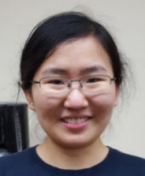
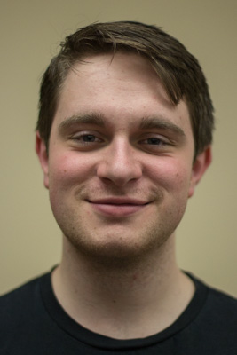
Support crew
TA: Nic Olsen, Department of Mechanical Engineering
nicholas.olsen@wisc.edu
TA: Lijing Yang, Department of Mechanical Engineering
lyang296@wisc.edu
Sysadmin: Colin Vanden Heuvel
Will take care of the hardware & software side of things
The person taking care of Euler

Slide 8
The Course Webpage
Course website managed under Canvas: https://canvas.wisc.edu/courses/190689
Canvas page contains links to
Piazza discussion forum: https://piazza.com/class/k5crmnymtx95c0
Conferencing tool
Drop box
Grades
Etc.

Slide 9
Course Related Information
A link to the “today’s slides” emailed to you 15 mins before the beginning of each lecture
“slide deck A”
Link to PPT slides is also available online at class website (Canvas)
“slide deck B”
The official deck of slides is “slide deck B”
Rationale: I correct/augment the slides in the “slide deck A”. What’s in Canvas (“slide deck B”) it’s what you’ll probed on in the comprehensive exam

Slide 10

Course Related Information
Syllabus will contain info about
Reading assignments $⇐$ these are very important
Topics we cover
Homework due dates
Syllabus will likely change to reflect the day-to-day progress
Both the syllabus & course description available at the Canvas course website

Slide 11
Course Related Information
Lectures are video recorded. Available online, probably 60 mins after class is over
Download the recording here: https://mediasite.engr.wisc.edu/Mediasite/Catalog/catalogs/me_759_ccd

Slide 12
F2F Students: On your presence in the lecture room
The course capacity filled up in less than 24 hours
Room assigned: 48 seats
Only way to take more students was to let them in but ask to not necessarily show up
If you watch the recording, you are in business

Slide 13
ME759: Two Sections
Face-to-face (F2F):
107 students (as of 01/21/2020)
On-line programs
6 online students
IMPORTANT semantics aspect:
“online students” are students who are registered for an online degree
“online students” are not students who prefer to watch the lectures on-line

Slide 14
Office Hours
All times CST
Notes:
For online students: on the day of the office hours, please email us by 6:30 PM if you plan to utilize the office hours
Call or email to arrange for meetings outside office hours
F2F students
Monday: 1:00 – 2:30 PM (Nic, 4150ME)
Tuesday: 12:30 – 2:00 PM (Nic, 4150ME)
Wednesday: 2:00 – 3:30 PM (Lijing, 4150ME)
Thursday: 12:30 – 2:00 PM (Lijing, 4150ME)
Friday: 2:00 – 3:30 PM (Dan, 4150ME)
Online students (see NOTE below)
Monday: 7:00 – 8:00 PM (Nic, Canvas)
Tuesday: 7:00 – 8:00 PM (Lijing, Canvas)
Wednesday: 7:00 – 8:00 (Dan, Canvas)
Euler Supercomputer consultation (both F2F & Online students)
Any work day, by appointment (4150ME or online) with Colin, the Sysadmin

Slide 15
Diversity, at UW-Madison
Statements below lifted from https://diversity.wisc.edu
Diversity is a source of strength, creativity, and innovation for UW-Madison
We value the contributions of each person and respect the profound ways their identity, culture, background, experience, status, abilities, and opinion enrich the university community
We commit ourselves to the pursuit of excellence in teaching, research, outreach, and diversity as inextricably linked goals
The University of Wisconsin-Madison fulfills its public mission by creating a welcoming and inclusive community for people from every background - people who as students, faculty, and staff serve Wisconsin and the world

Slide 16
Rules of Academic Conduct [read the Course Description for a detailed account of what constitutes cheating]
You are encouraged to discuss assignments with other class students
Post and read posts on Forum
Getting verbal advice and suggestions from anybody when all parties are away from a computer is fine
copy/paste of non-trivial code is not acceptable
Non-trivial = more than a line or so
Includes reading someone else’s code and then going off to write your own
Use of third-party libraries that directly implement the solution of a HW/Project is not acceptable unless explicitly asked to do so
We will use Stanford’s Moss to detect code plagiarism

Slide 17
Cheating, consequences
First time
Everybody involved gets the assignment score to be zero
I will email the advisor[s] of the parties who stood to benefit
Second time
The Dean of your college will be brought into the loop
Historical data
People cut corners more often early on in the semester, when ME759 things are more stressful/chaotic
There are about three cases of cheating that we typically come across each semester

Slide 18
Textbook/Pointers to Info
No textbook is required, but there are some recommended books/docs:
R. Bryant and D. O’Hallaron, Computer Systems: A Programmer’s Perspective, Prentice Hall, 3rd Edition, 2015
NVIDIA, GPU Programming Guide, version 10.0
David B. Kirk and Wen-mei W. Hwu: Programming Massively Parallel Processors: A Hands-on Approach, Morgan Kaufmann, 2016
Jason Sanders and Edward Kandrot: CUDA by Example: An Introduction to General-Purpose GPU Programming, Addison-Wesley, 2010
Peter Pacheco: An Introduction to Parallel Programming, Morgan Kaufmann, 2011
T. Mattson, et al.: Patterns for Parallel Programming, Addison Wesley, 2005

Slide 19
Another source of info: ME459
ME459: “Computing Concepts for Applications in Engineering”
The less mature brother of ME759
ME459: learning about basics, getting started in computing in science and engineering
ME759: using parallel processing, in the pursuit of speed
There is a 2.5 weeks worth of content overlap between ME459 & ME759
A lot of reading assigned from the ME459 slides

Slide 20
ME459: quick overview of topics covered
Shell programming (bash, sh)
The Linux command line
Remote access (of Euler) via ssh
Scheduling for execution on Euler
Version control with git
Elements of C programming
Building/linking/debugging/profiling
Build management with CMake
Instruction Level Parallelism issues
The memory hierarch
Caches
Virtual memory
Finite precision arithmetic
Vectorization
Elements of code optimization
Elements of operating systems
There is an expectation that you are familiar with the concepts above or are ready to go through some of the ME459 slides and assigned readings

Slide 21
ME759: Course Related Information
Course offered on an accelerated track
Three lectures per week, each 75 minutes long
Why accelerated track?
Gives us one month to work on a meaningful Final Project (more on this later)
Last lecture: April 10 or so
28 lectures: Just like a regular semester yet compressed in 2.5 months
After April 10:
Office hours will run as before
Homework will continue to be assigned

Slide 22
Schedule, looking ahead
No class on the following dates (Dan out of town):
February 14, March 30, April 1, April 3
Won’t affect the class – we’ll still conclude after 28 lectures, on April 10

Slide 23
Final grade breakdown
Homework 45%
Final Project 25%
Final Exam 25%
Course Participation 5%
Total 100%
NOTE:
Questions related to homework/exam scores must be raised within seven days after receiving the grade

Slide 24
Assignments
There will be 12 assignments
Assigned on Th, due next Th (one week turnaround)
Homework due at 9 PM on Th
Class demanding because of the time-consuming assignments, particularly early on
First three or four assignments: start early, give yourself plenty of time
It’ll be challenging to set up a process to work on your assignment
Use Piazza to ask questions about how to get going on Euler, about the work process
Notes:
DAN: say about participation

Slide 25
Assignments
On the due date, your git repo will be pulled at 9 pm to get the material graded by the TAs
Anything that goes into your repo after 9 pm will not be picked up
Another way of saying that “no late work will matter”
Two assignments with lowest scores will be dropped when computing your final HW score
Notes:
DAN: say about participation

Slide 26
Assignments: Nuts and Bolts
Each of you will have own git private repo. Everything will be under git-enabled version control
Setting up your git repo: part of the first assignment, instructions provided to you
TAs and instructor have access to your private git repo
More instruction provided in each assignment

Slide 27
Assignments: Nuts and Bolts
Grader will run a script at 9:0 PM that will pull your assignment solution.
Files that are not pushed prior to 9:00 PM are not going to be picked up by the scripted git pull operation
Grader will check solutions on Linux, running on the Euler cluster
You’ll be expected to use CMake to manage the build process
Covered in ME459, see reading assignment in syllabus

Slide 28
Re-emphasizing, the “late homework” issue
There are more than 100 students in this class
We will not offer exceptions for late work. The only way possible to keep a level playing field
The mechanism in place for accommodating this: you have to assignments that you don’t do
If you must change due date of homework/project: contact us at least 3 weeks in advance
Examples, what would fly: attending a conference, deadline for research project, etc.
In most cases, homework deadline will be moved early for you (and you’ll get the assignment early too)

Slide 29
Hitting the Ground Running
First assignment goes out tomorrow (emailed to you)
Available on the class website
Due in one week
Th, January 30, at 9 PM
Assignment is a C programming warm up + learning the Euler ropes

Slide 30
Exams-related issues
No midterm exam
Final exam will be comprehensive – April 15, at 7 pm
There will be a review session for the Final Exam,
April 14, at 7 pm
Organized online, through Canvas
Review session will be recorded

Slide 31
759 Final Project
Final Project Proposal due on March 27 (9 PM, in Canvas)
You’ll receive feedback by April 3
Final Project due at the time when the Final Exam starts
Exact date TBA

Slide 32
Final Project
Final Project (accounts for 25% of final grade)
Your work on Final Project to start no later than April 4:
It is an individual project or outcome of a 2- or 3-student team
You choose a problem that suites your research or interests
I encourage you to tackle a meaningful problem
Attempt to solve a useful problem rather than a problem that you are confident that you can solve
Projects that are not successful are ok, provided you aim high enough and demonstrate good work

Slide 33
Example, Previous Final Project: GPU Scheduling on a Cluster
2011 Final Project
Used today at the Large Hadron Collider (LHC) – CERN
One petabyte of data processed every day
The equivalent of around 210,000 DVDs
The center hosts 11,000 servers with 100,000 processor cores
Some 6000 changes in the database are performed every second
The Grid runs more than two million jobs per day
For some jobs, LHC used the Condor Scheduler
Started at UW-Madison, Professor Miron Livny
Two Condor students took 759 back in the day…
[https://home.cern/about/computing]→

Slide 34
Final Project: Default Options
In case you don’t have any research topic that you could use as a vehicle for this project I’ll provide at least two default choices
Project 1: work with a granular dynamics code
Profile existing code
Improve performance of the implementation via parallel computing
Project 2: work on fluid dynamics code
Profile existing code
Improve performance of the implementation via parallel computing
These two projects are ongoing work in my lab

Slide 35
Class Participation
Accounts for 5% of final grade
Participate on Piazza
Get involved in what goes on during lecture (if you choose to show up)
Forum: a quick way to get your questions answered by TA/instructor/other ME759 colleagues
Piazza forum was critical in the past – very useful resource

Slide 36
Examples, Piazza related
Post on Piazza your approach to working on your Windows box and interacting with Euler, which runs Linux
Remote connection tools/approaches
Automatic authentication for login
File access (mounting Euler as a drive in Windows Explorer)
Shell customization
How to clone the git repo
How to use a debugger other than gdb
Etc.

Slide 37
Class Participation, Examples
To all you good citizens out there: please answer questions on Piazza
Ideally, you’d beat the TAs and instructor to suggesting a fix or answering a question
Don’t worry if you only get it 75% right – no problem…

Slide 38
Scores and Grades
Score Grade
93-100 A
86-91 AB
78-85 B
70-77 BC
60-69 C
50-59 D
Grading will not be done on a curve
Final score will be rounded to the nearest integer prior to having a letter assigned
Example:
85.59 becomes AB
85.27 becomes B

Slide 39
Staying in Touch…
Email me only if you have a personal problem
Examples:
Good: Schedule a one-on-one meeting outside office hours
Bad: Asking me clarifications on Problem 2 of the current assignment (this needs to be on the Forum)
Bad: telling me that you can’t compile your code (this should also go to the Forum)
Any course-related question should be posted on the Forum
We continuously monitor the Forum
If you can answer a Forum post, please do so (counts towards your 5% class participation and helps me as well)
Keeps all of us on the same page
The forum is **very** useful

Slide 40
Prerequisites
This is a high-level graduate class in a fluid topic
Familiarity with C is expected
You can probably be fine if you are a friend of Java
You are expected to be at ease with handling ME459 concepts
Modest programming skills and a perseverant spirit are necessary
Understanding pointers
Being able to wrestle with a compile error on your own
You have heard of a debugger
You have heard of a profiler

Slide 41
We’ll speak C in this class. And some entry level C++
ME759: One-semester journey in the pursuit of speed
C programming is what’s being used for low level stuff. Because it’s fast
The Linux kernel is written in C. And the Windows kernel
A low level language like C is not friendly but the sky is the limit: you can do as you wish
We’ll use entry level C++ for some features that are clunky in C
CUDA, OpenMP, MPI: they cater to the C programmer (and FORTRAN too)

Slide 42
Hardware Aspects
The course designed to leverage a dedicated CPU/GPU cluster
Called Euler
Each student receives an individual account that will be used for
GPU computing
OpenMP multi-core computing
MPI-enabled parallel computing
Version control (through git)
Advice: if possible, do all the programming on a local or CAE machine. Move to Euler for “production” runs
Do the homework on your favorite laptop or desktop
Caveat: make sure your code runs on Euler since there’s where the TA will run your code

Slide 43
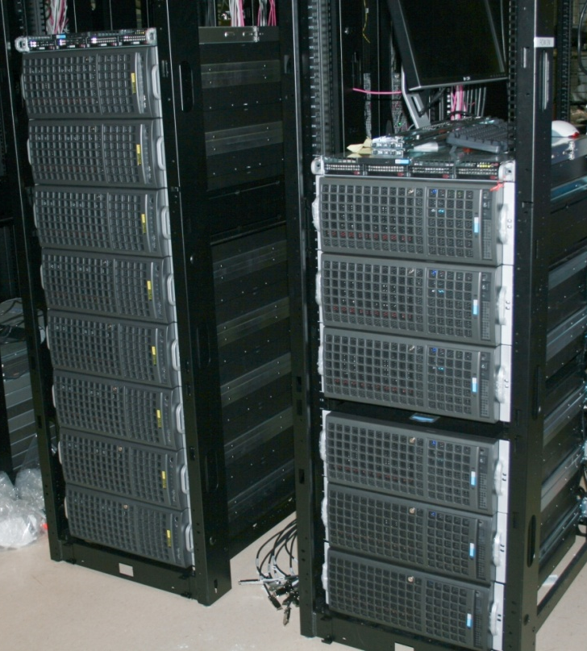
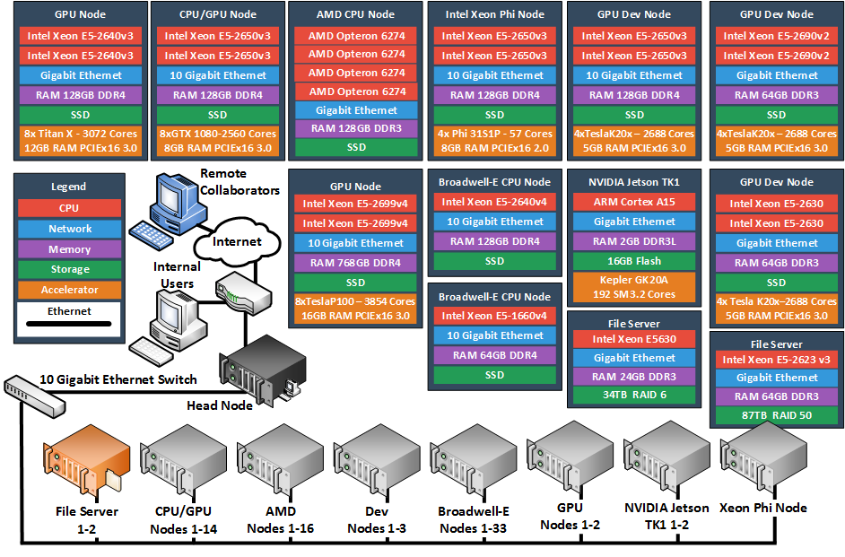
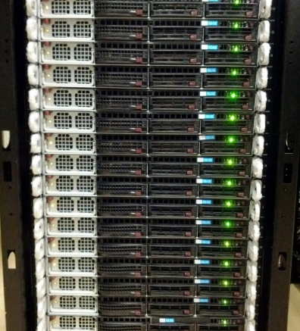
The Euler Cluster [pic is obsolete, but gives you an idea]
http://wacc.wisc.edu/infrastructure/

Slide 44
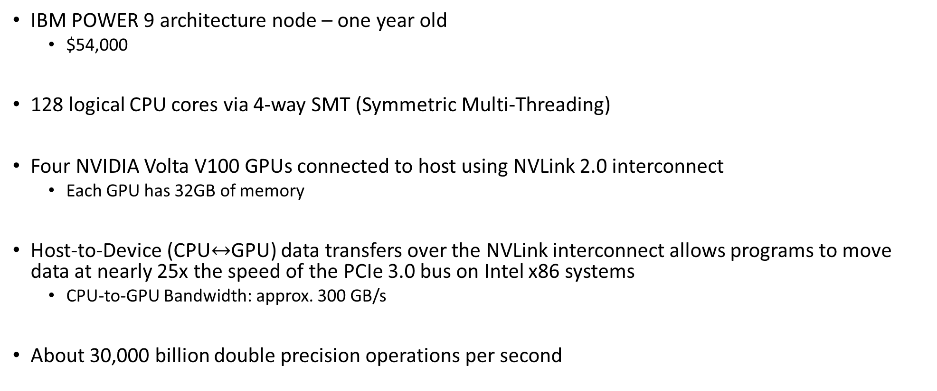
Example, an Euler node
IBM POWER 9 architecture node – one year old
$54,000
128 logical CPU cores via 4-way SMT (Symmetric Multi-Threading)
Four NVIDIA Volta V100 GPUs connected to host using NVLink 2.0 interconnect
Each GPU has 32GB of memory
Host-to-Device (CPU$↔$GPU) data transfers over the NVLink interconnect allows programs to move data at nearly 25x the speed of the PCIe 3.0 bus on Intel x86 systems
CPU-to-GPU Bandwidth: approx. 300 GB/s
About 30,000 billion double precision operations per second

Slide 45
Supercomputer [mis]use
Euler: over 200 accounts each year
Crashing Euler is not good
Stuff is due: assignments, project deadlines, research, papers, conference presentations, etc.
Gold rule: do not run your code on the Euler *head* node
“head node” – where you land when you ssh into Euler
Head node used to schedule how the entire supercomputer works
Through Slurm scheduling you will get your job scheduled for execution
Execution will take place on a Euler node
The said Euler node is chosen by the scheduler, in a process transparent to you

Slide 46
Supercomputer [mis]use
Your account will be temporarily blocked if you run code on the head node
You’ll need to email Dan and Euler sysadmin to unblock your account
Pay attention, particularly right before the homework is due
That’s the worst time to get your account frozen

Slide 47
Software Issues
Operating system of choice: Linux
Euler runs CentOS Linux release 8
Miscellaenous libraries/releases:
CUDA: 10.2
OpenMPI: 3.1
OpenMP: 4.5
Compilers and such
GCC 8.2.1 for most of your homework
clang 9.0.0 and PGI 19.10 for some OpenMP/OpenACC jobs

Slide 48
Software Issues
For build management – we’ll rely on makefiles generated with CMake
Scripts will be available to you in order to facilitate compile/link/debug/profile process
CMake: See assigned reading in syllabus
Debugging and profiling tools:
gdb: debugger under Linux
cuda-gdb: debugger for CUDA applications running on the GPU
NVIDIA Profiler: Nsight
Most of these tools are embedded in Visual Studio and Eclipse
OK to work under Windows, yet make sure your code compiles/runs on Euler before submitting

Slide 49
Course Emphasis
There are multiple choices when it comes to implementing parallelism
PThreads, Intel’s TBB, OpenMP, MPI, Ct, Cilk, CUDA, etc.
Course focuses on parallelism enabled by
CUDA running on Graphics Processing Unit (GPU) cards, for fine-grain parallelism
OpenMP standard, aimed both at fine and coarse-grain parallelism
Message Passing Interface (MPI) standard, aimed at coarse grain parallelism

Slide 50
Course Objectives
Get familiar with today’s software and hardware that can speed up your code
Mostly done through parallel computing, at multiple levels
Recognize applications/problems that can draw on advanced computing
Gain basic skills that will help you map these applications onto a parallel computing hardware/software stack
Write code, build, link, run, debug, profile
Introduce basic software design patterns for parallel computing
Expand your mindset when it comes to writing software for scientific computing

Slide 51
Course Objectives [Cntd.]
What I’ll try to accomplish
Provide enough information for you to start writing software that can leverage parallel computing to hopefully reduce the amount of time required by your simulations to complete
I will not attempt to…
Propose new parallel computing languages or language features
Establish how compilers should support advanced computing
Etc.
To summarize,
We are interested in this stuff since we are consumers of parallel computing

Slide 52
How we’ll go about it…
Before talking about how to write software to run on a piece of hardware, we’ll learn something about that hardware asset
“learn something” – pick up those things we need to know as *programmers*
Level of detail provided not enough to be useful to people whose interests are in hardware
Focus not on low level hardware detail
Dedicated courses already available
E C E 353: Introduction to Microprocessor Systems
E C E 354: Machine Organization and Programming
E C E 552: Introduction to Computer Architecture
E C E 752: Advanced Computer Architecture I

Slide 53
“High Performance Computing for Applications in Engineering.” Why This Title?
Computer Science: ISA, Limits to Instruction Level Parallelism and Multithreading, Speculative Execution, Pipelining, Memory Hierarchy, Memory Models, Cache Coherence, etc.
Long story short: how should a processor be built?
Electrical Engineering: how will we build the processor that the CS colleagues have in mind?
Lots of microarchitecture issues
Science & Engineering: we’re faced with solving large problems
This class: Use parallel computing to solve these large problems

Slide 54
The Big Picture
“Big Data”: everybody’s talking about it
Two parts to “Big Data”
Producing it (computer simulation)
Processing it (data analysis)
“In pursuit of speed” – this is the mantra of this course, that’s all ME759 attempts to offer

Slide 55
Overview of Material Covered
Warm up: Basic concepts related to sequential computing (review, some ME459 concepts)
Overview of parallel computation paradigms and supporting hardware/software
GPU computing and the CUDA programming model
OpenMP programming
MPI programming
Heterogeneous parallel computing with CUDA and/or OpenMP and/or MPI

Slide 56
At the Beginning of the Road…
This field (advanced computing) is very much in flux, high rate of change
There will be issues that I don’t know and/or don’t understand
I always end up learning something new, in most cases with your help
There might be questions that you ask for which I don’t have an answer
I’ll follow up on these and get back with you (on the Forum)
Most of my statements should be qualified by the preamble “On most systems…”, or “By and large…”
You can always find exceptions, relatively few true blanket statements that can be made

Slide 57
The ME759, how I see it
Class is time consuming because of the assignments
The Piazza forum is a place where you ME759 learn
There will be a lot of “googling” for the class
Dealing w/ situations when you’ll have to address pesky hurdles on your own

Slide 58
What ME759 offers
Access to top of the line hardware
Exposure to new programming techniques for speeding up computing in your work/research
In some cases, this might be a game changer
Winning ticket: top notch hardware + new programming approaches
Be bold (the opportunity presents itself w/ the Final Project)

Slide 59
The Price of reaching 1 Gflop/second
1961:
Combine 17 million IBM-1620 computers
At $64K apiece, when adjusted for inflation, this would cost $8.3 trillion
2000:
About $1,000
Kentucky Linux Athlon Testbed, a 64+2 node Beowulf cluster built by the University of Kentucky COE in 2000
2015:
8 cents
Celeron G1830 & Radeon R9 295X2 System
2018: 6 cents
NVIDIA GTX 1080 Ti @ $699 apiece
[Wikipedia]$→$

Slide 60
GPU Acceleration: Pascal P100
Pascal P100: 4,670,000,000,000 double precision FMA operations per second
Very high bandwidth: 720 GB/s
Amazing at data processing (data parallelism)

Slide 61
GPU Acceleration: Volta V100
Volta V100: 7,800,000,000,000 double precision FMA operations per second
Very high bandwidth: 900 GB/s
Amazing at data processing (data parallelism)

Slide 62
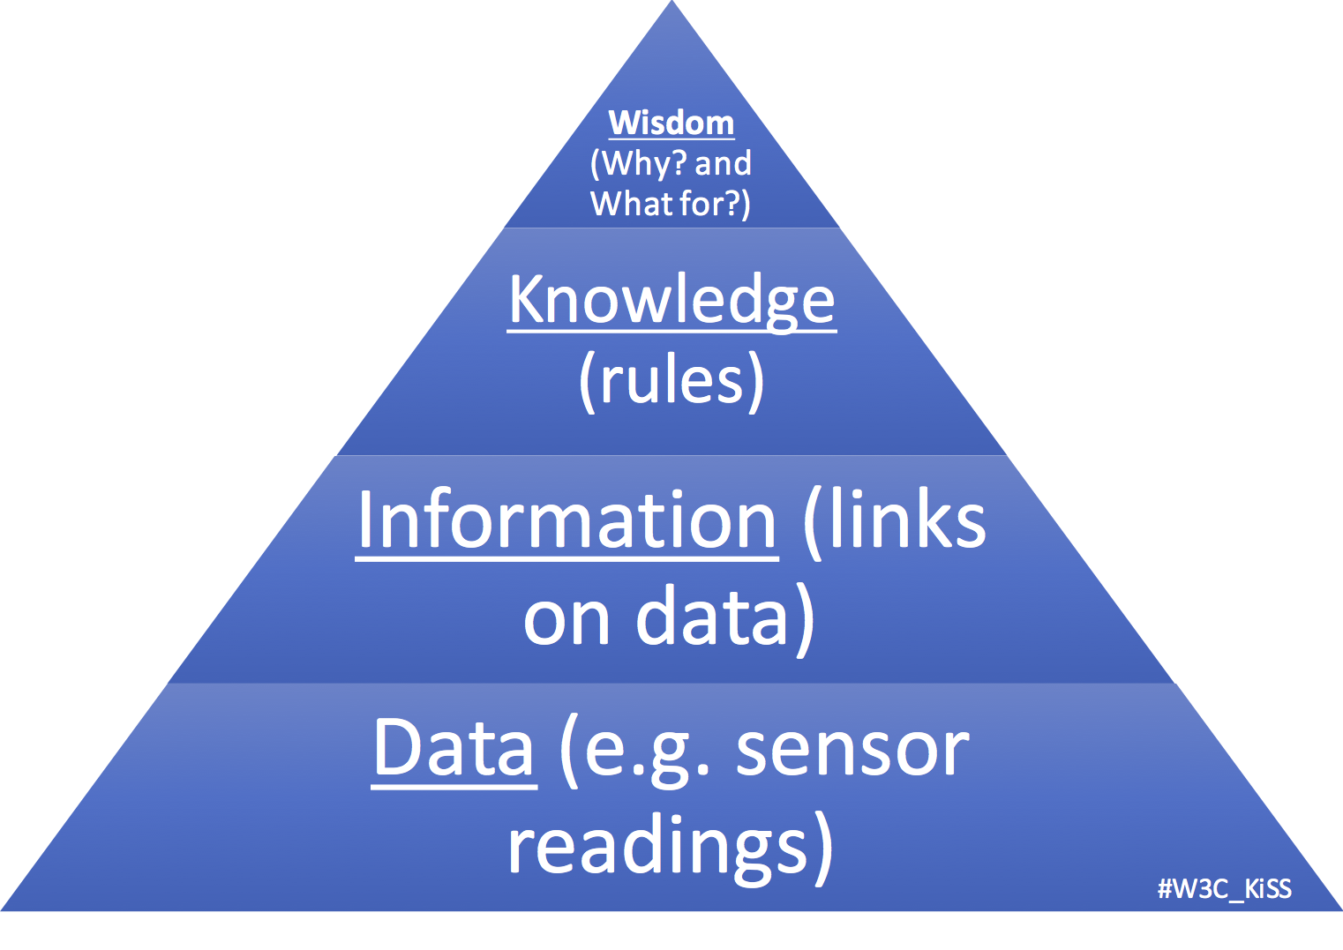
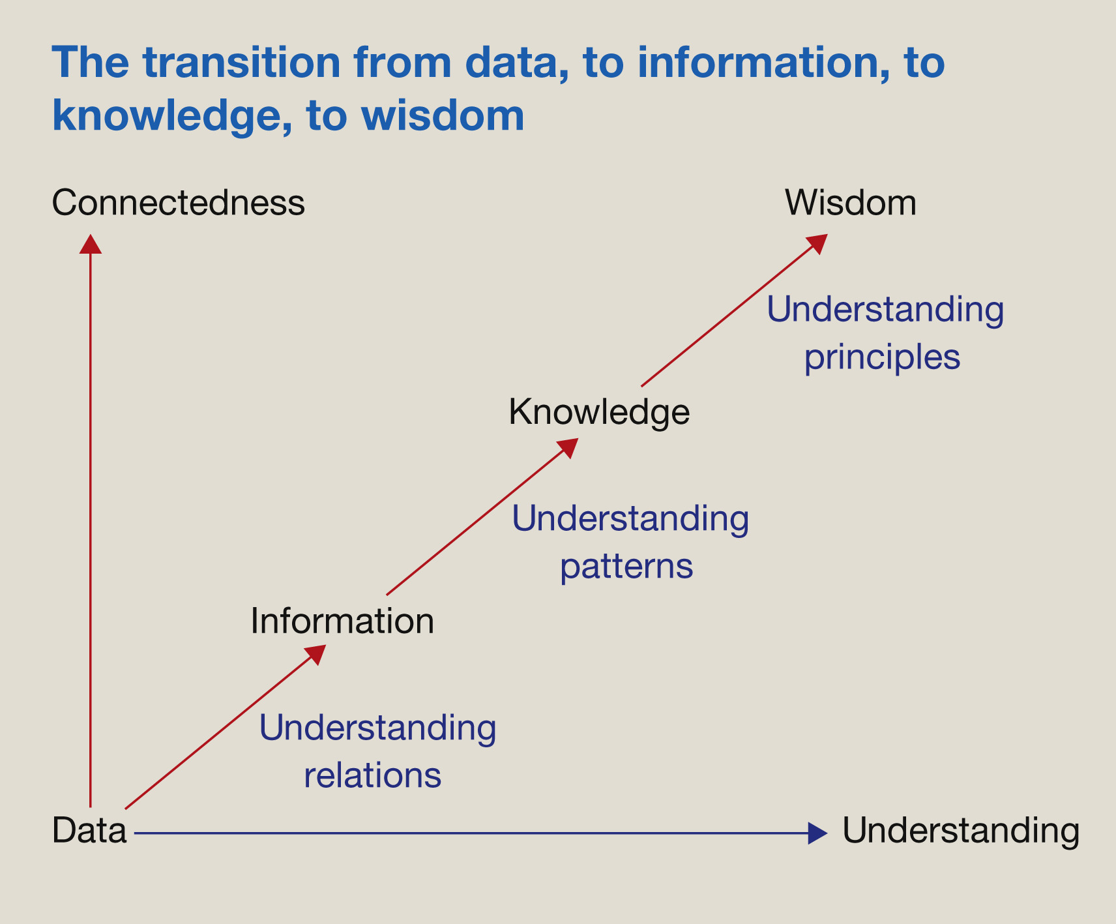
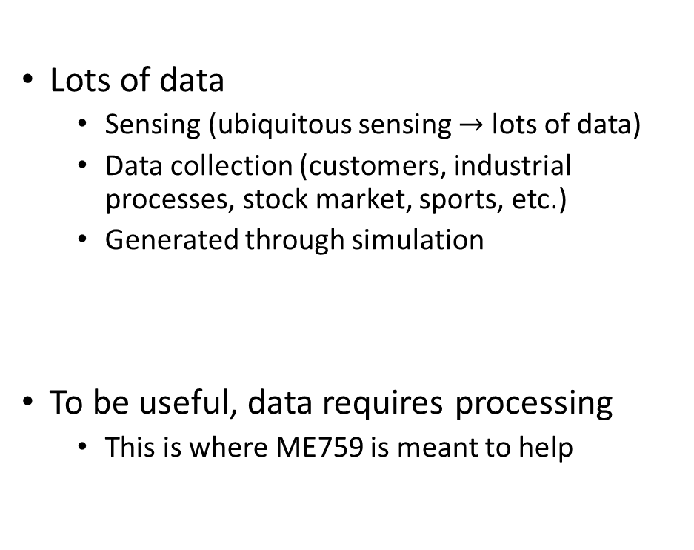
Computing a means to a goal: from information to wisdom
Lots of data
Sensing (ubiquitous sensing $→$ lots of data)
Data collection (customers, industrial processes, stock market, sports, etc.)
Generated through simulation
To be useful, data requires processing
This is where ME759 is meant to help
[https://www.w3.org/community/kiss/files/2017/02/DIKW.png]$→$
[https://www.sciencedirect.com/science/article/pii/S1472029916301813]$→$

Slide 63

High Performance Computing (HPC), and where useful
People from Oakridge National Lab, Argonne National Lab, Los Alamos National Lab:
HPC: The activity of using, for instance, 10,000 nodes to run one very large application
This application can’t be run on one machine: not enough memory space, for instance
People from ME759 and many other folks
HPC: The ability to tap into the resources of commodity hardware to extract speed for data generation and/or processing
Unlikely: You might have 10,000 nodes to use
Likely: you have one GPU, or four multi-core CPUs on one motherboard, or perhaps 10 nodes in a cluster
Measurement
Sensing
Simulation
HPC
HPC
Knowledge/Wisdom

